Slide 1
LINKED LIST

Slide 2
LINKED LIST
This is a special kind of list where data items are linked to one another.
Each data item has address of its next element.
Each data element is known as node and consists two parts:
1) Data part which contains the value
2) Next part which contains the address of the next element.
Data
Next
Node

Slide 3
OPERATIONS ON LINKED LIST
Following basic operations are performed on linked list:
Create a new linked list.
Traverse all the data items of the list.
Insert a new data item in the list at begin, end and specified position.
Delete a data item from the list from begin, end and specified position.
Search a data item and its memory location in the list.
Concatenate two linked list.

Slide 4
TYPES OF LINKED LIST
Basically, there are four types of linked list:
1) Singly Linked List:
Each node has two parts data and next.
Last node contains NULL value in next part.
A head node has the address of the first node.
Head Node
100
1
200
4
300
8
NULL
100
200
300

Slide 5
2) Doubly Linked List:
Each node has three parts data, pre and next. Here, pre contains the address of previous node.
Last node contains NULL value in next part.
First node contains NULL value in pre part.
A head node has the address of the first node.
Head node
100
pre
data
next
NULL
2
200
100
4
300
200
6
NULL
200
300
100

Slide 6
3) Circular Linked List:
Each node has two parts data and next.
Here, last node contains address of first node in next part.
A head node has the address of the first node.
Head Node
100
1
200
4
300
8
100
100
200
300

Slide 7
4) Circular Doubly Linked List:
Each node has three parts data, pre and next. Here, pre contains the address of previous node.
Last node contains the address of first node in next part.
First node contains the address of last node in pre part.
A head node has the address of the first node.
Head node
100
pre
data
next
300
2
200
100
4
300
200
6
100
100
200
300

Slide 8
SINGLY LINKED LIST
The structure of node is defined as:
struct node
{
int num;
struct node *next;
};
Here data part num contains integer value and next pointer stores the address of the next node.

Slide 9
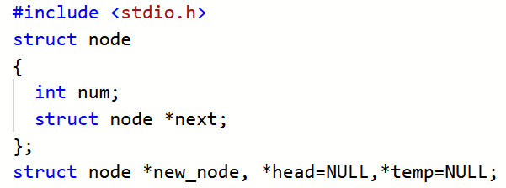
CREATION OF SINGLY LINKED LIST

Slide 10
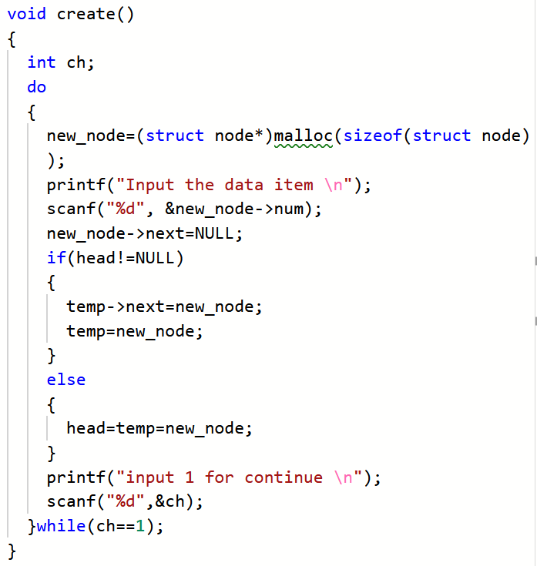

Slide 11
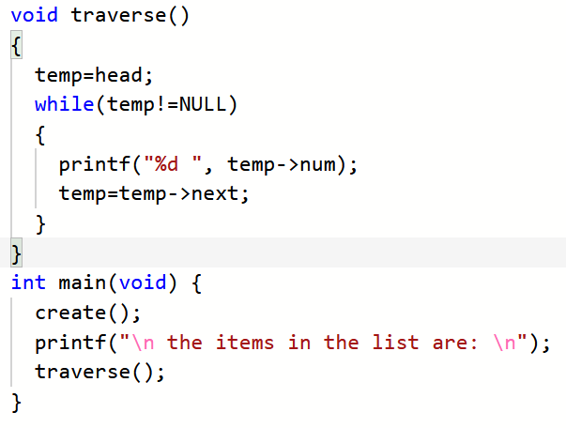
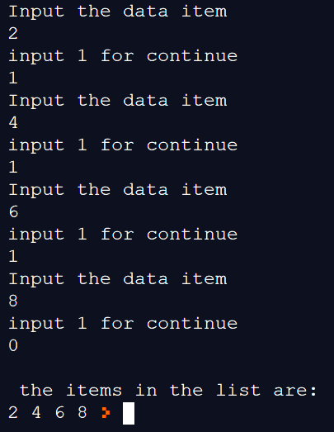

Slide 12
INSERTION AT THE BEGIN
Head Node
100
2
200
4
300
6
NULL
100
200
300
1
New Node
400
Head Node
400
1
100
2
200
4
300
6
NULL
400
100
200
300

Slide 13
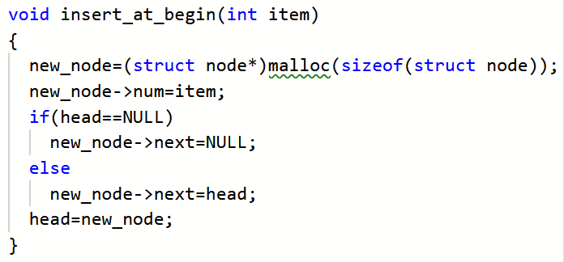

Slide 14
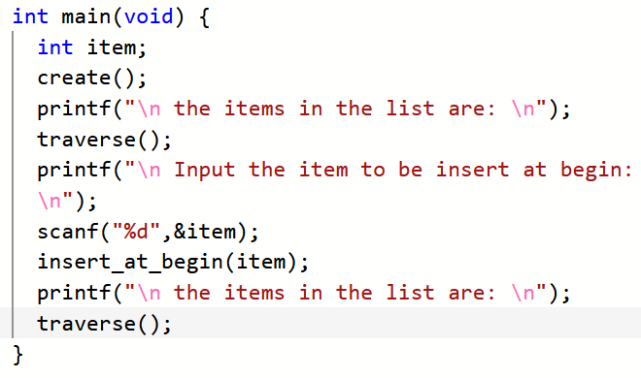
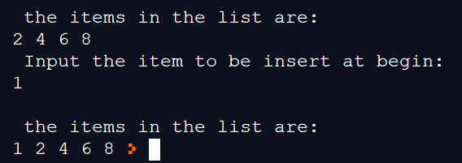

Slide 15
INSERTION AT THE END
Head Node
100
2
200
4
300
6
NULL
100
200
300
9
NULL
New Node
500
Head Node
100
2
200
4
300
6
500
9
NULL
100
200
300
500

Slide 16
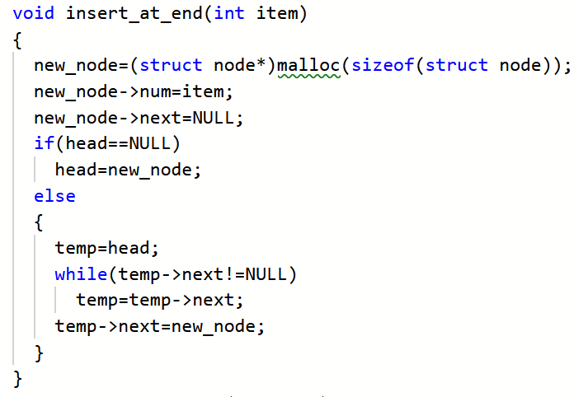

Slide 17
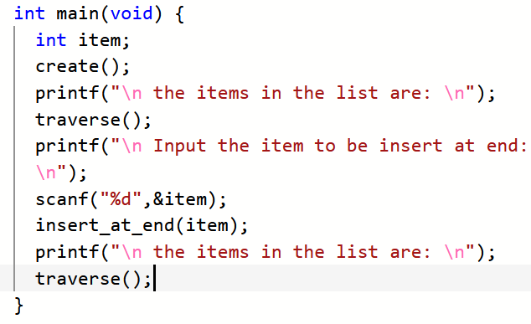
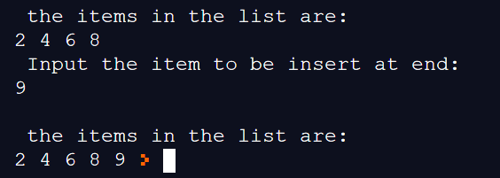

Slide 18
INSERTION AT SPECIFIED POSITION
Head Node
New Node
5
NULL
100
500
2
200
4
300
6
NULL
100
200
300
Head Node
100
2
200
4
500
5
300
6
NULL
100
200
500
300

Slide 19
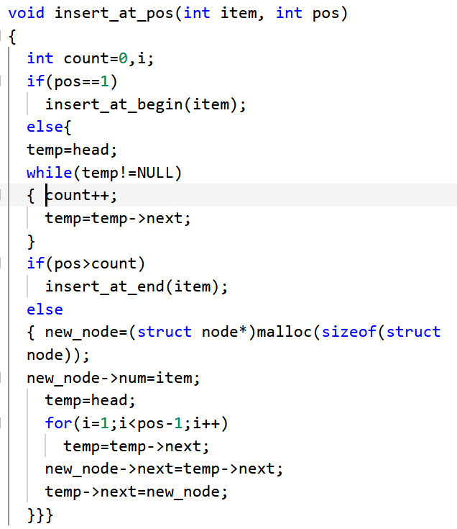

Slide 20
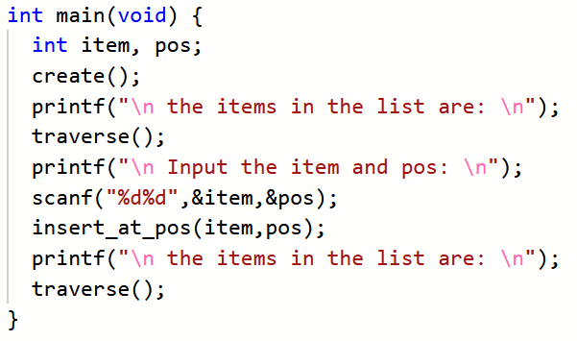
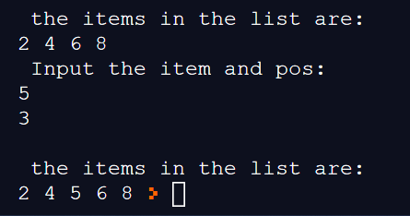

Slide 21
DELETE FROM BEGIN
Head Node
100
2
200
4
300
6
NULL
100
200
300
Head Node
200
4
300
6
NULL
200
300

Slide 22
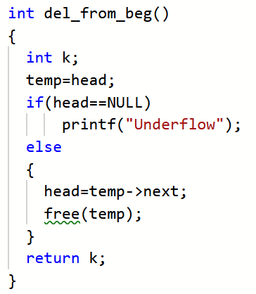

Slide 23
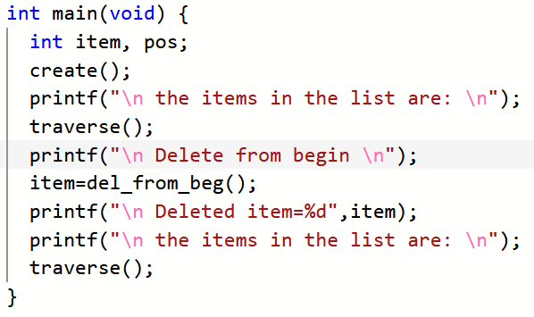
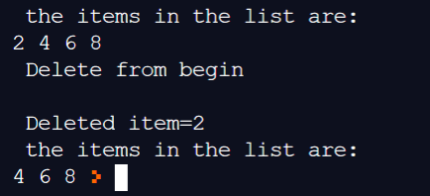

Slide 24
DELETE FROM END
Head Node
100
2
200
4
300
6
NULL
100
200
300
Head Node
100
2
200
4
NULL
100
200

Slide 25
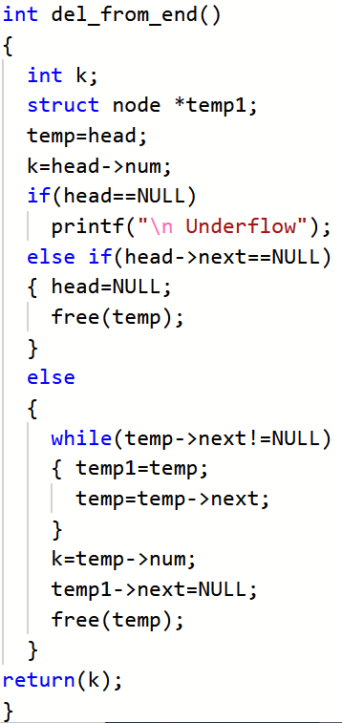

Slide 26
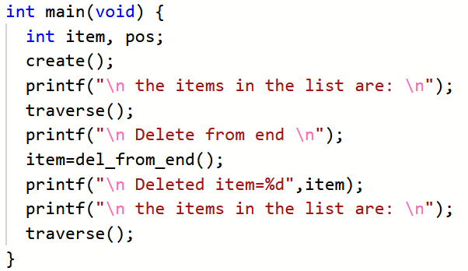
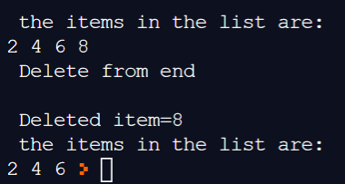

Slide 27
DELETE FROM SPECIFIC POSITION
Head Node
100
2
200
4
300
6
400
8
NULL
100
200
300
400
Head Node
100
2
200
4
400
8
NULL
100
200
400

Slide 28
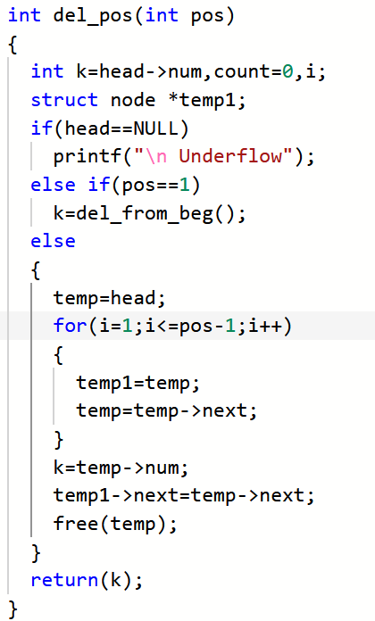

Slide 29
